Slide 1
QUALYS DEMO - PART 2
Lets have a look at the Qualys features

Slide 2
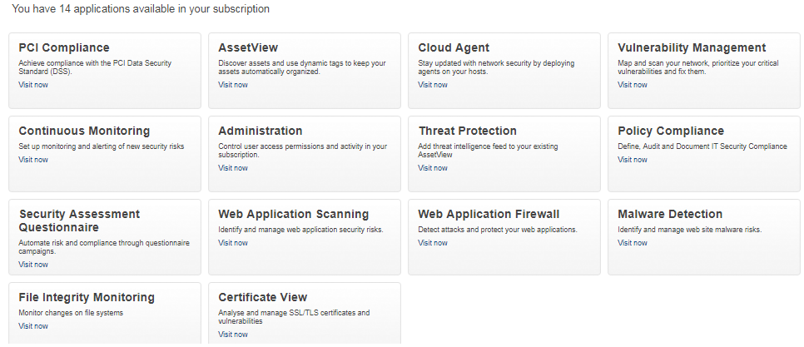
QUALYS DEMO - PART 2
QUALYS
14 APPLICATIONS

Slide 3
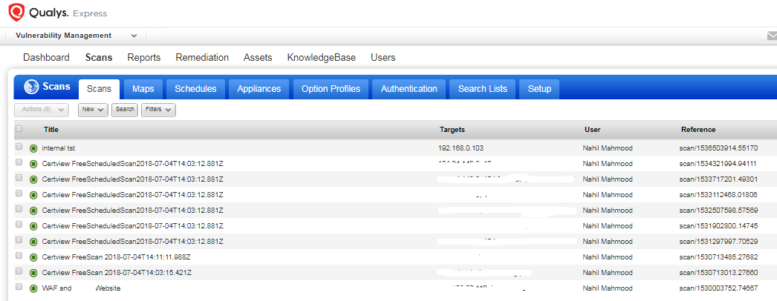
QUALYS DEMO - PART 2
VULNERABILITY MANAGEMENT DASHBOARD

Slide 4
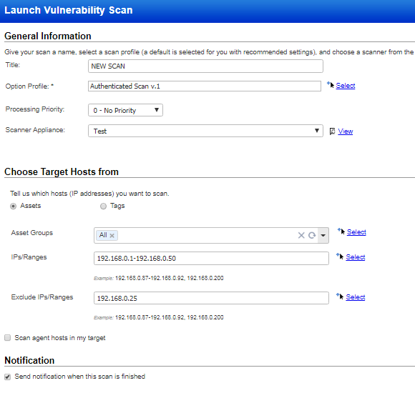
QUALYS DEMO - PART 2
LAUNCH VULNERABILITY SCAN

Slide 5
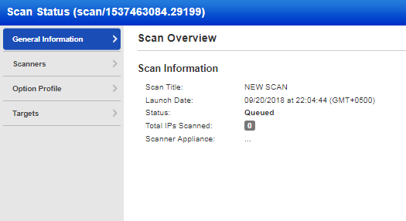
QUALYS DEMO - PART 2
SCAN INITIATED

Slide 6
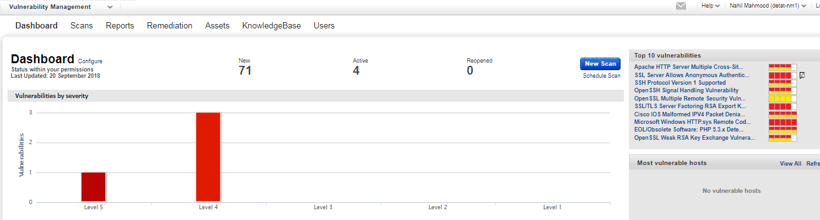
QUALYS DEMO - PART 2
VULNERABILITY MANAGEMENT DASHBOARD

Slide 7
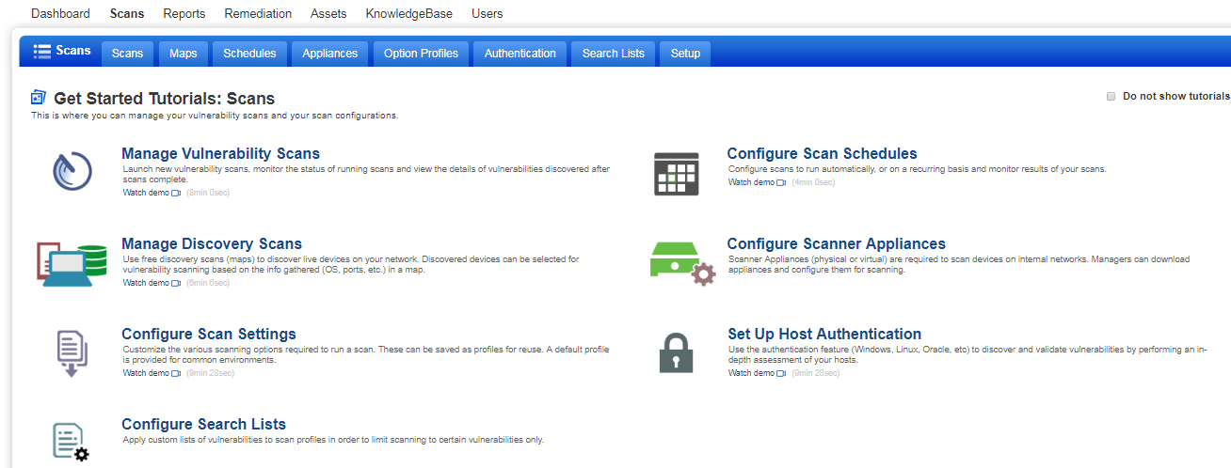
QUALYS DEMO - PART 2
VULNERABILITY MANAGEMENT DASHBOARD
SCAN TUTORIALS

Slide 8
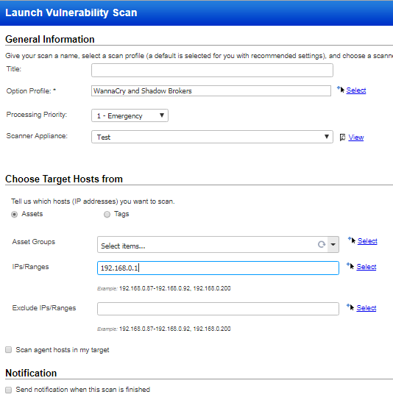
QUALYS DEMO - PART 2
WANNACRY & SHADOW BROKERS SCAN

